Slide 1
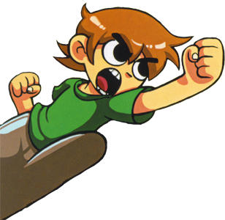
SCOTT PILGRIM
ROAD RAGE
MATTHEW DULLAHAN
JEREMY DAWSON
Winterfell Games

Slide 2
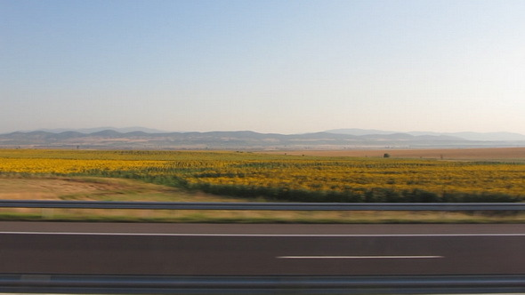

Score: 150

Slide 3
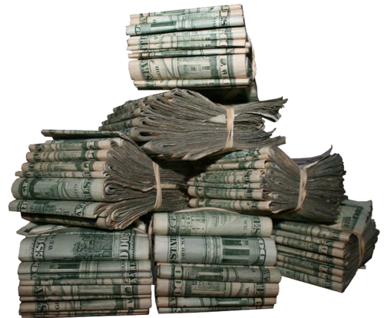
Score: 150

Slide 4
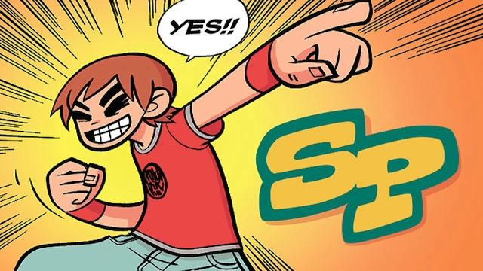

Slide 5
Score: 150

Slide 6

Press [SPACE] To Exit 150

